Slide 1
Customer activation and retention
SHUBHAM SHUKLA

Slide 2
Objective of the study
Our main objective of doing this project is to analyse whether the users are shopping products from e-commerce websites, how did they give feedbacks to these websites on the basis of several positive and negative factors and also the details of the users on basis of factors like age, gender, etc.
Also apply analytical skills to give findings and conclusions in detailed data analysis of E-retail factors for customer activation and retention.

Slide 3
BUSINESS MODEL
Customer satisfaction has emerged as one of the most important factors that guarantee the success of online store; it has been posited as a key stimulant of purchase, repurchase intentions and customer loyalty.
A comprehensive review of the literature, theories and models have been carried out to propose the models for customer activation and customer retention.
Five major factors that contributed to the success of an e-commerce store have been identified as: service quality, system quality, information quality, trust and net benefit.
The research furthermore investigated the factors that influence the online customers repeat purchase intention. The combination of both utilitarian value and hedonistic values are needed to affect the repeat purchase intention (loyalty) positively.

Slide 4
Conceptual Background
The data is collected from the Indian online shoppers. Results indicate the e-retail success factors, which are very much critical for customer satisfaction and retention.
Five major factors that contributed to the success of an e-commerce store have been identified as: service quality, system quality, information quality, trust and net benefit.
The research furthermore investigated the factors that influence the online customers repeat purchase intention.

Slide 5
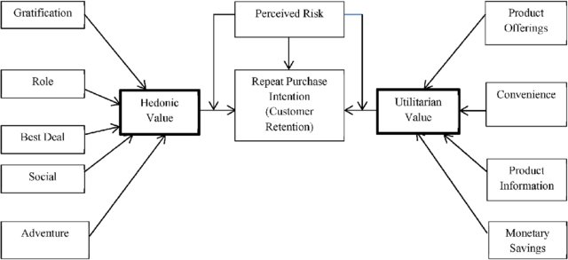
Diagrammatic Representation of Customer Retention

Slide 6
TOOLS USED IN PERFORMING TASK
Microsoft excel
Pandas
NumPy
Seaborn
Matplotlib
Jupyter Notebook

Slide 7
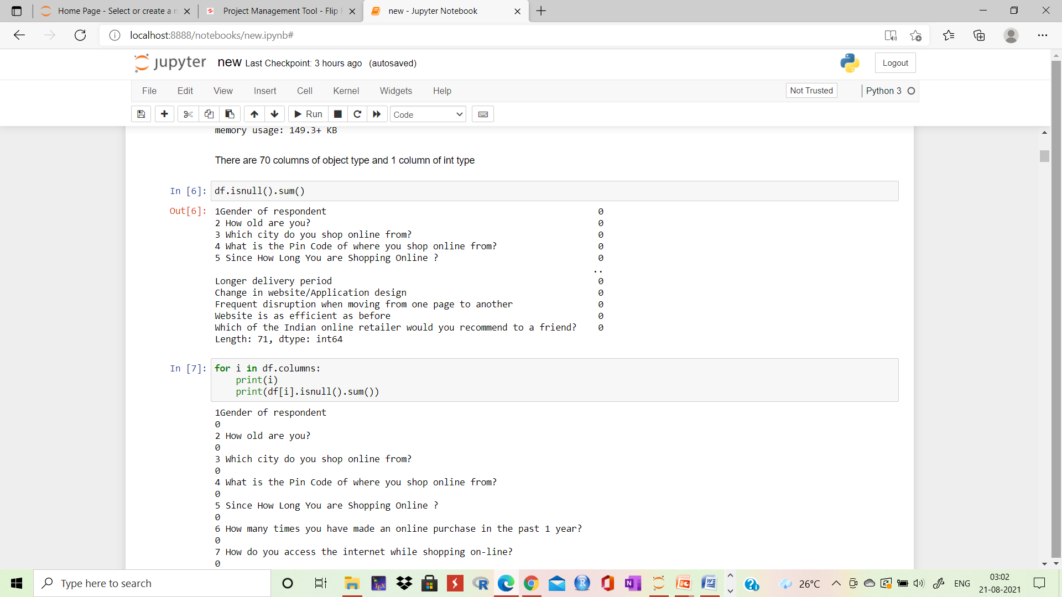
DATA ANALYSIS
There is no null value in this dataset and 70 columns are of object type and 1 column is of int type.

Slide 8
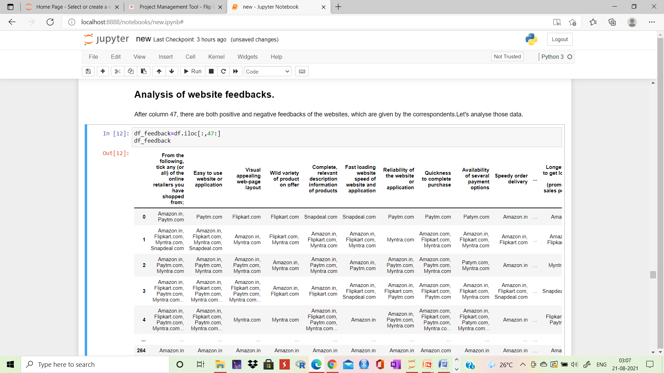
Analysis of website feedbacks obtained
From here we will extract only the feedbacks data and then save it in a new data frame, which will be used for further process.

Slide 9
Observations for positive data
Amazon and Flipkart rank about 90% in satisfying customers, followed by Myntra.
The maximum percentage Paytm and Snapdeal could score here is 83 and 71 respectively.
No one is willing to refer Snapdeal to their contacts as it has the less percentage among all websites.
On an average, Snapdeal and Paytm scores are less when compared to amazon, flipkart and Myntra.

Slide 10
Observations for negative data
Around 65% of Paytm customers are not happy with their delivery period and longer term in loading pages.
Approx. 60% of Snapdeal customers are not happy about their limited mode of payment and nearly 50% of people are not satisfied in longer time of displaying graphics.
We can observe that even though with count wise, Amazon and Flipkart showed more negative reviews. When we take percentage, in top 10, Amazon has appeared only once and flipkart has not even appeared even one time.
The highest percentage Myntra got is 51, whereas flipkart's highest percentage is 46. However, other websites like Paytm, snapdeal.com have got highest percentage for negative reviews around 60-67%.
In terms of less dissatisfaction, myntra.com and flipkart are better, followed by amazon.

Slide 11
Observations from the count plot
There are more women respondents than men. It could be that data collection is mainly focused on women.
Amongst the respondents, the major class targeted is between 21-40 years, followed by 41-50 and less than 20 years. We can understand that the correspondents are mostly from working class.
The respondents are majorly residing in cities like Delhi, Greater Noida, Noida and Bangalore.
Majority are shopping online for more than 4 years. There are considerable people who are shopping online since less than one year and also it shows that many new customers are being added every year.
We can observe that many have shopped less than 10 times in the past year.
Many of them use mobile to shop online, followed by laptop, desktop and tablet.
Windows constitute the major OS of the customer device, followed by Android and Mac.

Slide 12
Google Chrome is majorly used to access the shopping website.
People are becoming customers of their favourite stores by using the search engine. Content marketing or display advertisements are not that impactful when coming to online marketing. So, companies should spend more on advertising on search engines.
For repeated visits, people use search engine first, followed by app and direct URL. We can see that difference between app and search engine is small.
Majority of the people spend more than 15 minutes before making a purchase, followed by 6-10 minutes.
The major payment method used by all is credit/debit cards, followed by COD and e-wallets.
People have mentioned that sometimes they would leave the cart without purchasing and the major reason they have mentioned is that they are finding some better alternative offer. It means that people are comparing from many online websites before making any purchase.
Customers strongly agree that content of website must be easy to read and understandable.
Majority of customers want information of similar products to make purchase.
Majority of the customers want complete information on listed sellers and their products being offered.

Slide 13
Customers want all relevant information on the listed products and very less customers disagree to that.
The customers wanted the websites to be easily navigated.
Majority of the customers wanted high loading and processing speed, user friendly interface of website, convenient payment method, high trust on website, empathy towards customers, guarantee privacy of customers, responsiveness-availability of several communication channels, etc.
People feel that online shopping provides monitory benefits and discounts.
Customers also feel that shopping online is convenient and flexible.
Return policy is important for deciding the product purchase to many customers.
Many customers find shopping through online helps them financially because of cost and discount factors.
When it comes to certain factors like gratification, social status enhancement because of shopping, or whether shopping online gives a thrill or adventure, customers are more indifferent to these. So, there is an ample scope in giving more enhanced experienced to customers in this regard.

Slide 14
CONCLUSION
1) Site or application ought to be not difficult to utilize.
2) Visual engaging website page format ought to be engaging and simple to utilize (Easy to understand).
3) Site should offer assortment of items with all the significant data on the items is fundamental.
4) Dependability of the site or application is vital. This forms trust with the client and this forms a feeling of customized connection with the site or application.
5) Speed to finish buy and a few installment strategies is vital. This expands accommodation, saves time and empowers deal.
6) Expedient request conveyance and satisfying guarantees made is fundamental. This makes business a brand.
7) Next perception would be the Information Security of the client. Information Assurance would be the most essential piece of the business as there are separate government strategies to guarantee security. Site or Application ought to guarantee Information Security and Information Assurance.
8) Next perception would be Client support or after deals administrations. Better and dependable help supports deal and client maintenance. This administrations is likewise an imperative part of this business. This help likewise investigates returns and substitutions. This is a comfort and energizes trust and deals.
9) Site and application should stack quicker and simple to utilize. Every one of the components, button and so on, ought to be effectively reachable or noticeable.
10) Next perception would be unwaveringness programm or benefits for each buy is significant. Advancements, references and advantages draws in client and holds clients.
11) Generally popular and preferred site in India would be "AMAZON.IN", "FLIPKART.COM" and "MYNTRA.COM".

Slide 15
THANKYOU

